Slide 1
Missing Heirs and Unknown Mineral Owners Issues of Lease and Conveyance in the Marcellus & Utica Shales
ALSO FIND US ON
http://www.linkedin.com/companies/216795
http://www.facebook.com/Steptoe.Johnson

Slide 2
Goals
Understand the purpose of the statutes
Understand what a missing heir is
Understand how to search, and when to stop

Slide 3
Why Do We Care About Missing Heirs?
Mineral development is affected by the laws of cotenancy
WV - need 100% of interests leased before drilling
PA – each cotenant has the right to develop, but must account to other cotenants
OH – combination, but unsettled

Slide 4
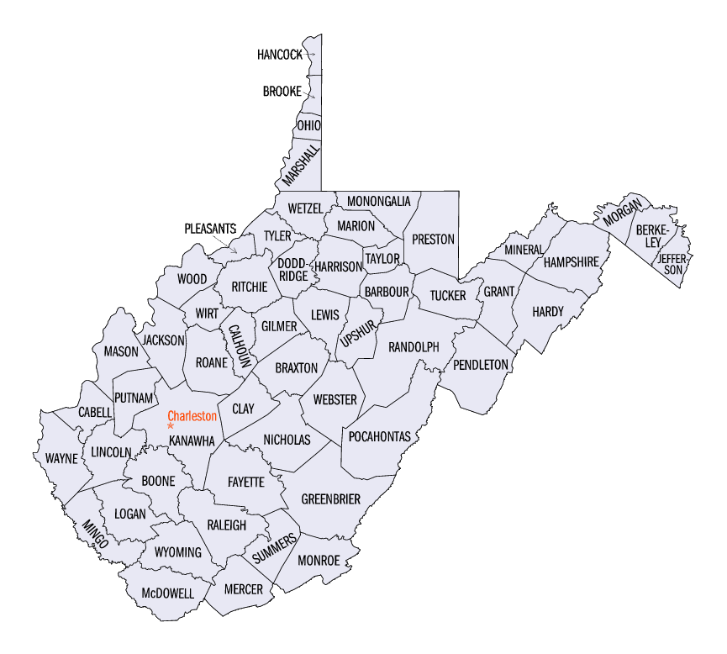
West Virginia

Slide 5
Governing Law
W. Va. Code § 55-12A-1 et seq.

Slide 6
Intent of Legislature
“To facilitate development of coal, oil, gas, and other minerals, as part of the public policy of the State, by removing certain barriers to such development caused by interests in minerals owned by unknown or missing owners or by abandoning owners.”

Slide 7
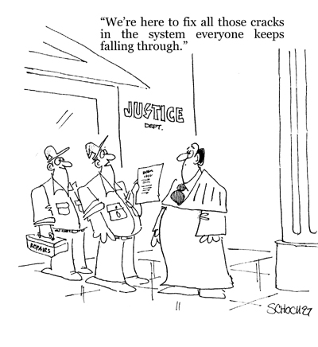
They’re from the Government, and they’re here to help….

Slide 8
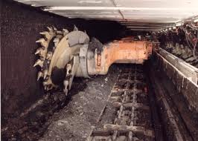
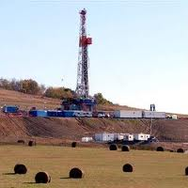
“Mineral Development”
Mining coal
Drilling for and producing oil or gas
By conventional techniques
By enhanced recovery by injection of fluids of any kind into the producing formation

Slide 9
Who Can File Action?
Owner of an interest in surface estate
Owner of an interest in minerals sought to be developed
Lessee, assignee, or successor to lessee, under valid & subsisting mineral lease

Slide 10
Where Can the Action be Filed?
Circuit Court of county where mineral, or major portion of mineral, is situated.
If the relevant tract straddles two or more counties, the action must be brought in the county where the majority of the tract sits

Slide 11
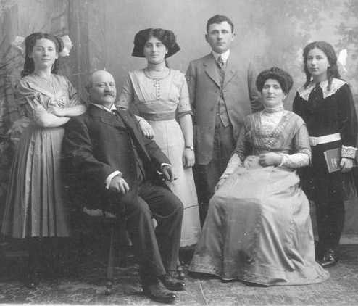
Just Who Are Missing Heirs?

Slide 12
“Unknown or Missing Owner”
Person vested with title whose present identity or location cannot be determined from records of:
Clerk of the County Commission
Clerk of Circuit Court where property is located
Diligent inquiry in vicinity of owner’s last known place of residence
Sheriff
Assessor

Slide 13
Due Diligence to Find Missing Heirs
When is enough enough? When the judge says so!
Due diligence includes but is NOT limited to:
All county records where property located
All county records in missing person’s last known county of residence
Online resources
Newspapers, especially obituaries
Interviews with relatives
DOCUMENT all efforts in sworn affidavit
If you don’t make a diligent effort, the judge will send you back for a re-do

Slide 14
Parties to be Named in Petition
All unknown or missing owners or abandoning owners having record title
Unknown heirs, successors, and assigns of all such owners not known to be alive

Slide 15
The Petition Itself
Petition MUST contain, among other things:
Standing of petitioner to file
Identity of defendants and ownership interest of each
Legal description of land at issue
Nature of proposed development
Efforts to locate unknown or missing owners, usually by affidavit
Petitioner must sign and verify accuracy of petition
The devil is in the details!

Slide 16
Exhibits to Attach to Petition
Certified copy of most recent recorded instrument embracing interest to be leased
i.e., last deed in record room
Additional instruments necessary to show vesting title
i.e., affidavits of heirship
Certified copy of all leases of record for tract
Certified copy competing lease or easement

Slide 17
Service of Petition
Personal service, if possible
But if this was possible, they wouldn’t be missing!
How Petitions Are Actually Served
Via publication in newspaper
File Notice of Lis Pendens in County Clerk’s office
17

Slide 18
Guardian Ad Litem
Once the action is filed, the Court appoints a guardian ad litem to represent the missing heirs
GAL must confirm they are missing AND being treated fairly by lessee
GAL paid by Petitioner

Slide 19
Waiting is the Hardest Part…
After filing and serving, the petitioner must wait SIX MONTHS before the Court can appoint a Special Commissioner to execute the lease on behalf of the missing heirs.

Slide 20
After Six Long Months….
…it’s time to go to Court for the first hearing
HOPEFULLY, the GAL will have done his/her due diligence and filed a report recommending the lease.
Petitioner may have to testify about efforts to locate missing heirs.
If the Court is satisfied that the Petitioner searched diligently for the missing heirs, it should appoint the Special Commissioner to sign the lease.
If the Court is NOT satisfied with the Petitioner’s search, it can require additional due diligence.
Petitioner will have to post bond for Special Commissioner.

Slide 21
Special Commissioner’s Duties
Once appointed, he or she:
Signs lease on behalf of missing heirs
Files report with Court recommending Court approval
Usually, we all then go BACK to Court for the final hearing

Slide 22
Final Hearing
Court will accept reports of GAL and Special Commissioner
Order payments to GAL and Special Commissioner
Approve lease
Special Commissioner signs lease
Record lease
Pay money for lease into court receiver

Slide 23
Special Receiver of Court
Holds & invests lease money for use and benefit of missing heirs.
If authorized by court, may use up to 10 percent of funds to continue the search for missing heirs.
23

Slide 24
Lucky Sevens
Within SEVEN years after the lease is signed, missing persons can move the Court to reopen the matter in an attempt to prove their interest
If after seven years NO ONE comes forward, the Court shall begin the process of conveying the minerals and accumulated royalties to the surface owner

Slide 25
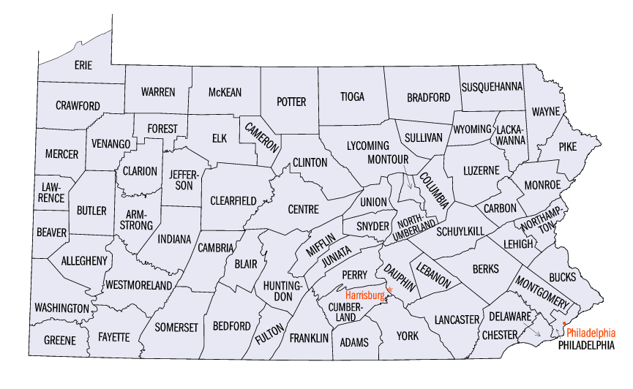
Pennsylvania

Slide 26
Governing Law
58 P.S. § 701.1, et seq.

Slide 27
Purpose of Dormant Oil and Gas Act
“To facilitate the development of subsurface properties by reducing problems caused by fragmented and unknown or unlocatable ownership of oil and gas interests and to protect the interests of unknown or unlocatable owners of oil and gas.”

Slide 28
Purpose of Dormant Oil and Gas Act
“not . . . to vest the surface owner with title to oil and gas interests that have been severed from the surface estate…”

Slide 29
WHO are Missing Heirs?

Slide 30
Jurisdiction
Court of common pleas in the county in which the tract or any portion thereof is located.

Slide 31
Function of Statute
Petition court to declare a trust in favor of missing heirs
Petitioner can be…
Fee owner
Lessee
Royalty Owner
Owner of correlative rights

Slide 32
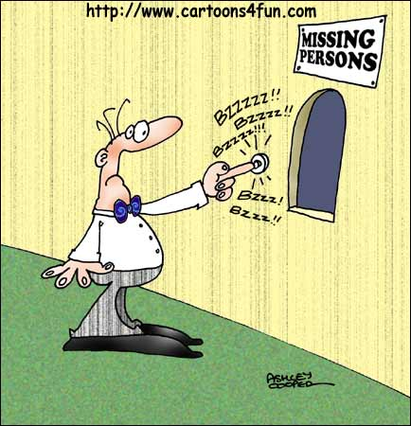
Requirements of Petitioner
Diligent effort to locate/identify owner!
Unable to identify or locate present residence or other address
Appointment of trustee in best interest of all owners of interests in the oil & gas

Slide 33
Financial Institution
If petitioner meets requirements, court appoints financial institution as trustee to execute and deliver one or more oil & gas leases.

Slide 34
Administration of Trust
All bonuses, rental payments, royalties & other income is paid to trustee
Trust is perpetual!
If the missing heirs are found, trustee distributes as per court order.

Slide 35
Liability of Lessee
Lessee who pays trustee are not liable for claims by unknown owners.
But failure to pay within 6 months
of due date makes lessee liable for attorney fees, court costs for collection, and interest to date of payment.

Slide 36
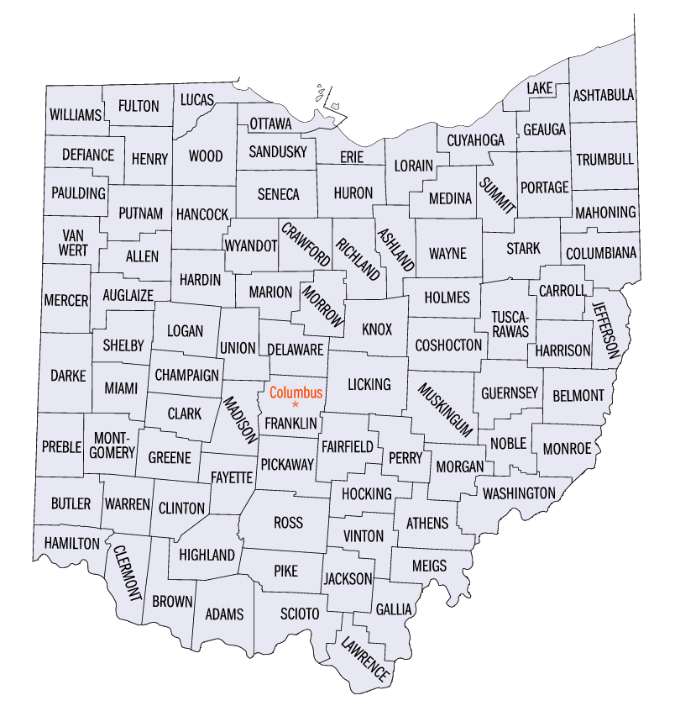
Ohio

Slide 37
Governing Law
Ohio Revised Code § 5301.56
Dormant Minerals Act

Slide 38
General Rule
Court Not Required!
Any mineral interest held by any person, other than the surface owner, shall be abandoned and vested in surface owner if:
1. Surface owner takes TWO actions, and
2. None of THREE conditions apply.

Slide 39
First Action
Serve notice on mineral owner of surface owner’s intent to declare mineral interest abandoned.
If personal service not possible, serve by publication (at least once).
Note that ONLY THE SURFACE OWNER can initiate this process.

Slide 40
Second Action
File affidavit of abandonment between 30-60 days in each county where land located.
Owns surface
Reference to recorded instrument on which mineral interest is based
Statement mineral interest was abandoned
Recitation of facts of abandonment
Statement of service

Slide 41
The Three Exclusions
1. Can’t be coal (If mixed, non-coal minerals may be deemed abandoned).
Can’t be owned by the United States, Ohio, or any of their political subdivisions, body politics, or agencies.
Within past 20 years, at least ONE of the following has occurred:

Slide 42
Three Exclusions, con’t.
i. The mineral interest was the subject of a title transaction of record;
Production;
Underground gas storage operations;
iv. Holder used drilling permit;
v. Claim to preserve mineral interest is filed;* or
vi. A separately listed tax parcel number has been created in county auditor’s tax list & county treasurer’s duplicate tax list

Slide 43
*Claim to Preserve Mineral Interest
File within 60 days of notice
Must set forth nature of mineral interest and recording information
Comply with § 5301.52
Must set forth intent to preserve, not abandon, mineral rights
Notify surface owner of filing

Slide 44
Conveyance of Minerals
If mineral owner does not respond, the COUNTY RECORDER can transfer title to surface owner
i.e., “This mineral interest abandoned pursuant to affidavit of abandonment recorded in volume ___, page ___ .”
No Judge Required!
Immediately thereafter:
Mineral interest vests in surface owner, and
Record of mineral interest ceases to be notice of existence of mineral interest or any right thereunder.

Slide 45
Microfilm
If county recorder uses microfilm, memorial may be located on affidavit of abandonment instead of record on which severed mineral interest is based, and affidavit may be recorded.

Slide 46
Points to Takeaway
No magic bullet
A diligent search must always be made for missing heirs
In WV and PA, statutes offer some remedy for those missing.
OH dormant mineral statute allows mineral title to vest in surface owner if mineral owner has abandoned .

Slide 47
THANK YOU!
Questions?

