Slide 1
Oil & Gas vs. Solar
A land overview
Presented by: Phillip A. Guerra, JD, CPL

Slide 2
Disclaimer
The opinions expressed in this oral presentation and on the following slides are solely those of Phillip A. Guerra, JD, CPL (hereinafter, “author/presenter”), and not necessarily the opinion of ForeFront Power, LLC, or any affiliate of ForeFront Power, LLC. These materials have been prepared solely for educational purposes, reflect only the personal views of the author/presenter, and are not to be considered legal advice. Thus, the author/presenter and ForeFront Power, LLC, or any affiliate of ForeFront Power, LLC, cannot be bound either philosophically or as representatives of their various present and future customers, clients and/or partners to the comments expressed in these materials. While every attempt was made to ensure that these materials are accurate, errors or omissions may be contained therein, for which any liability is disclaimed.

Slide 3
Solar 101
A land overview

Slide 4
Types of Solar Projects
Behind-the-meter (BTM) – a system that generates power/electricity that can be used on-site without passing through a meter.¹
Front-of-the-meter (FTM) – a system that generates power/electricity to any location off-site that must pass through the meter before reaching the end-user.²
¹⁻² https://news.energysage.com/behind-the-meter-overview/

Slide 5
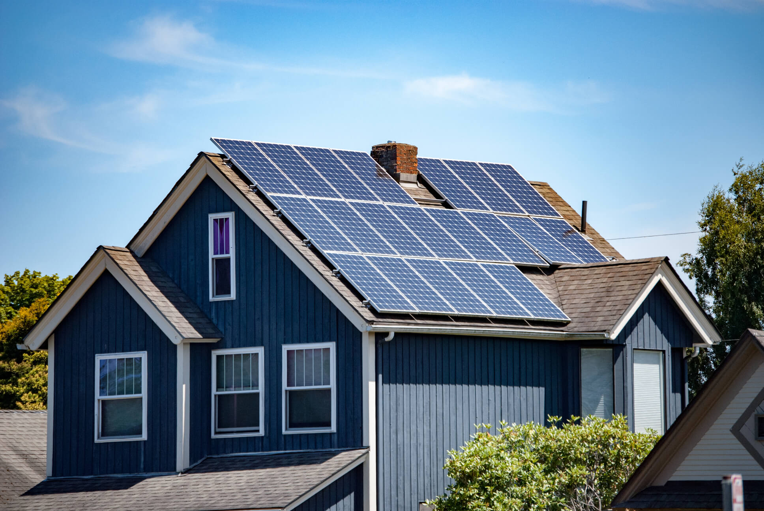
Residential
BTM

Slide 6
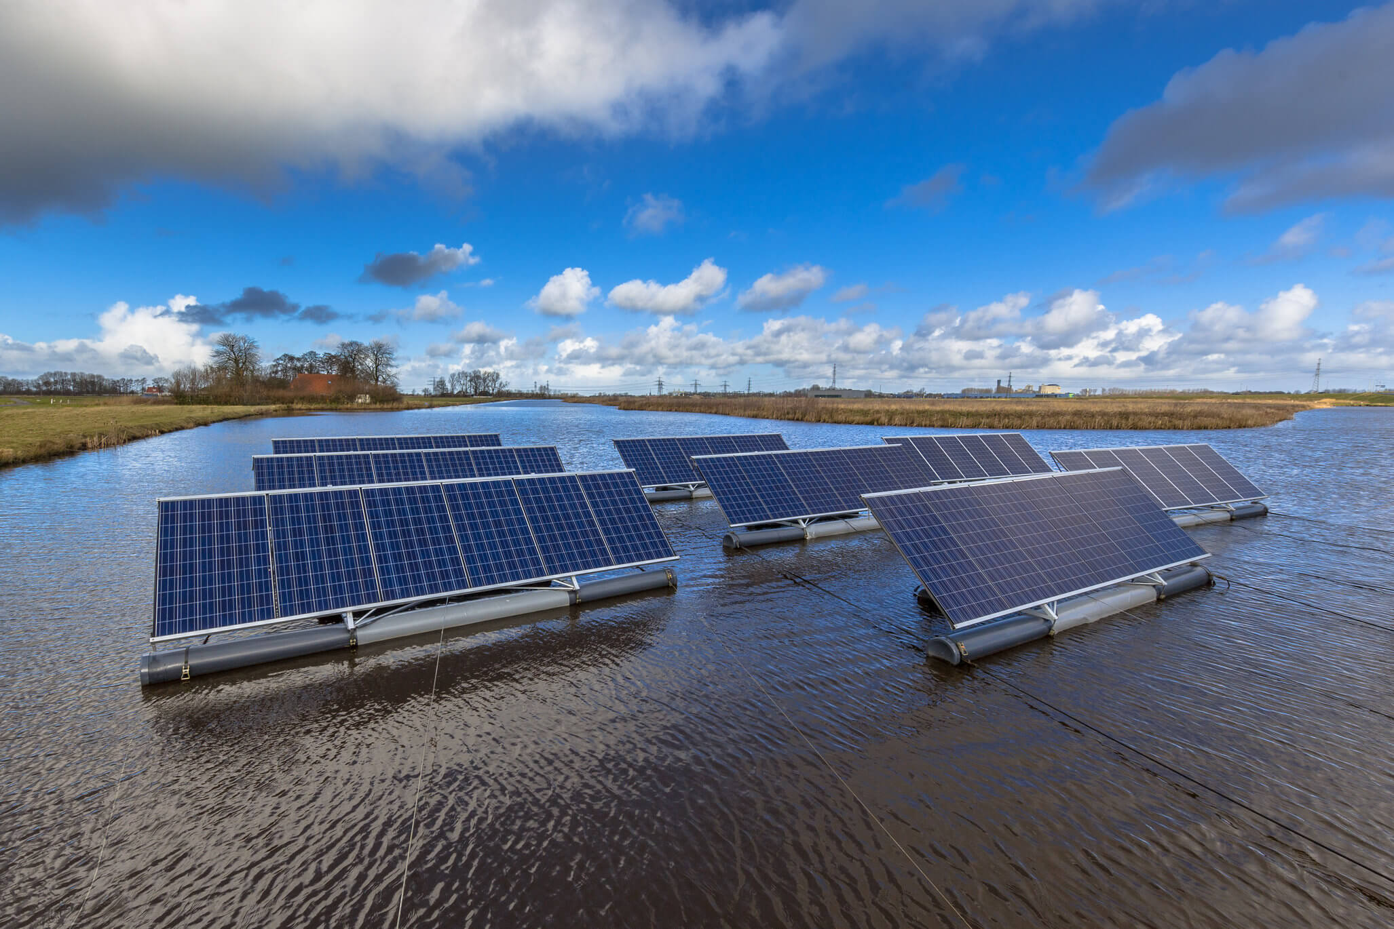
Floating
BTM

Slide 7
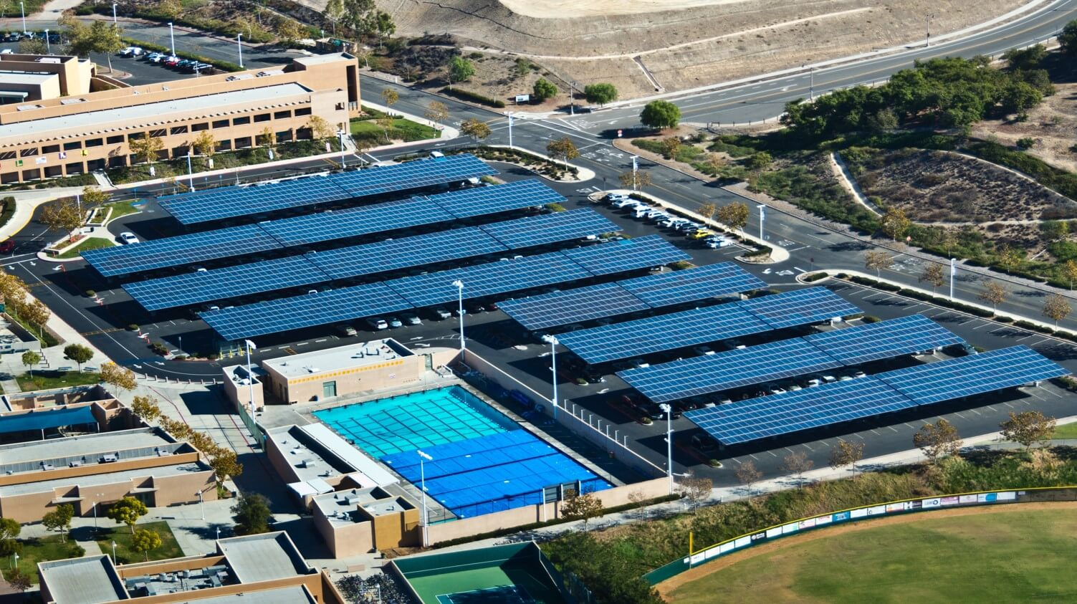
Canopy
BTM
FTM

Slide 8
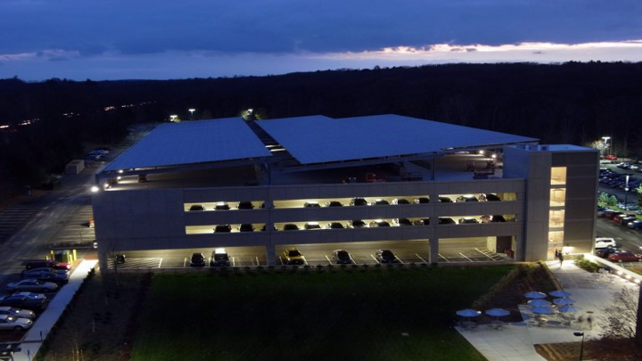
Parking Garage
BTM

Slide 9
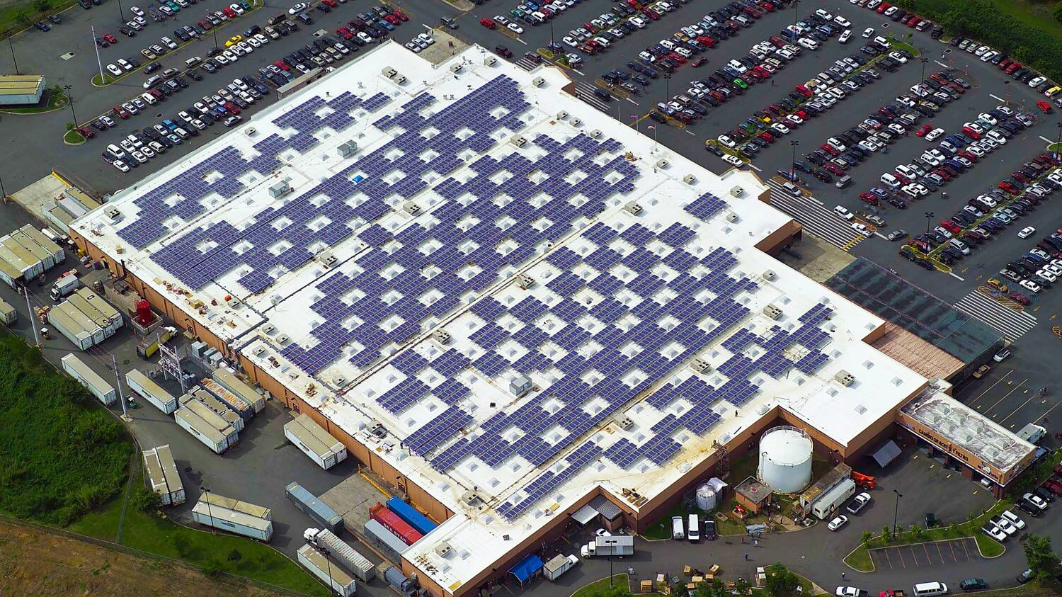
Rooftop
BTM
FTM

Slide 10
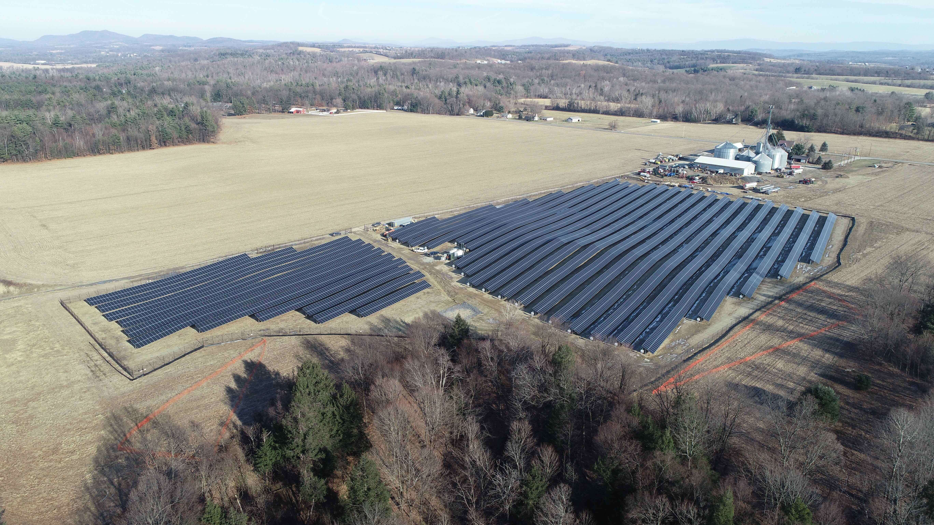
Ground Mount
Ground Mount
BTM
FTM

Slide 11
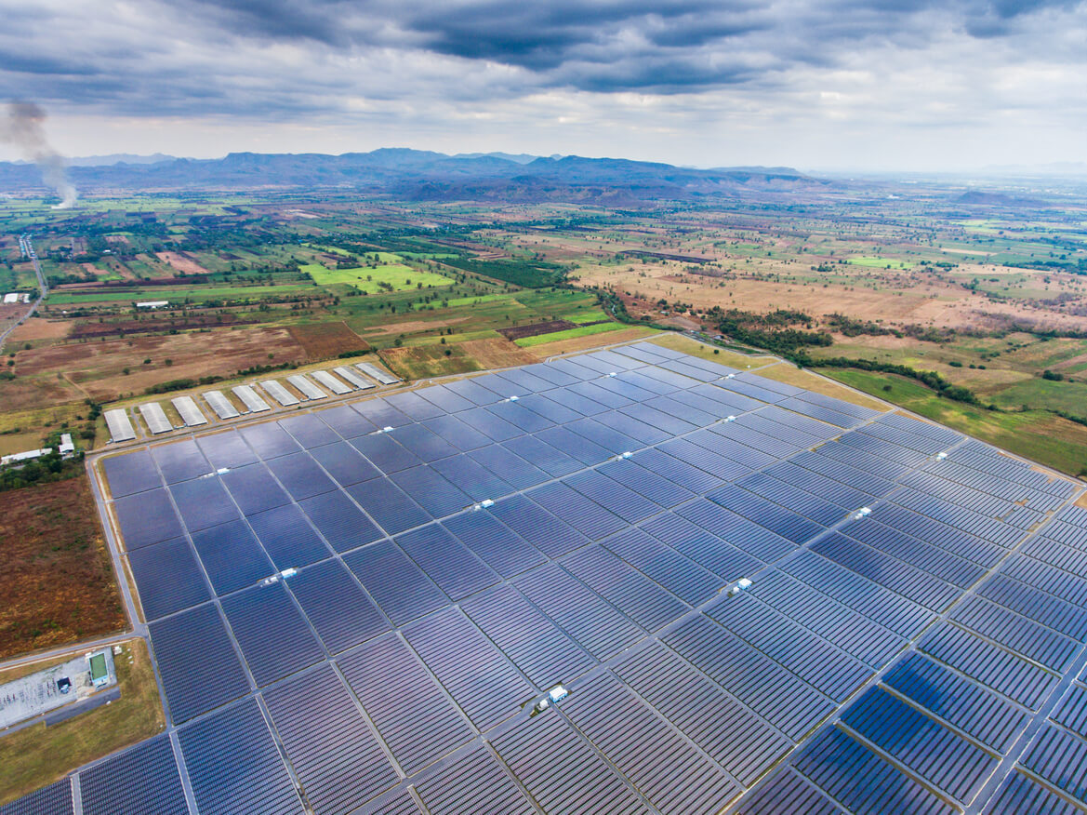
Utility-Scale
FTM

Slide 12
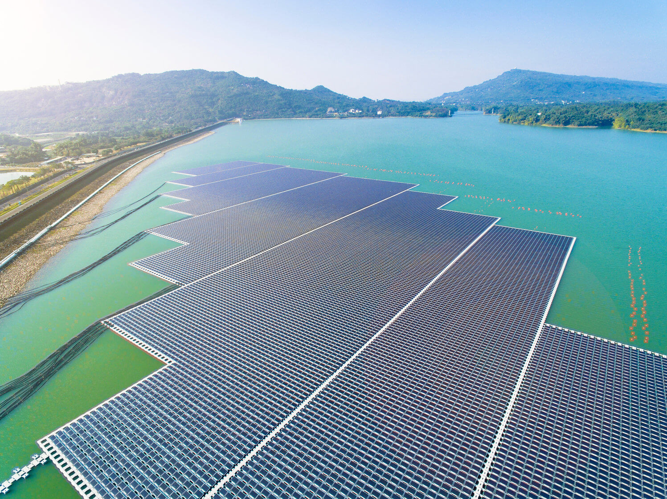
Utility-Scale
FTM

Slide 13
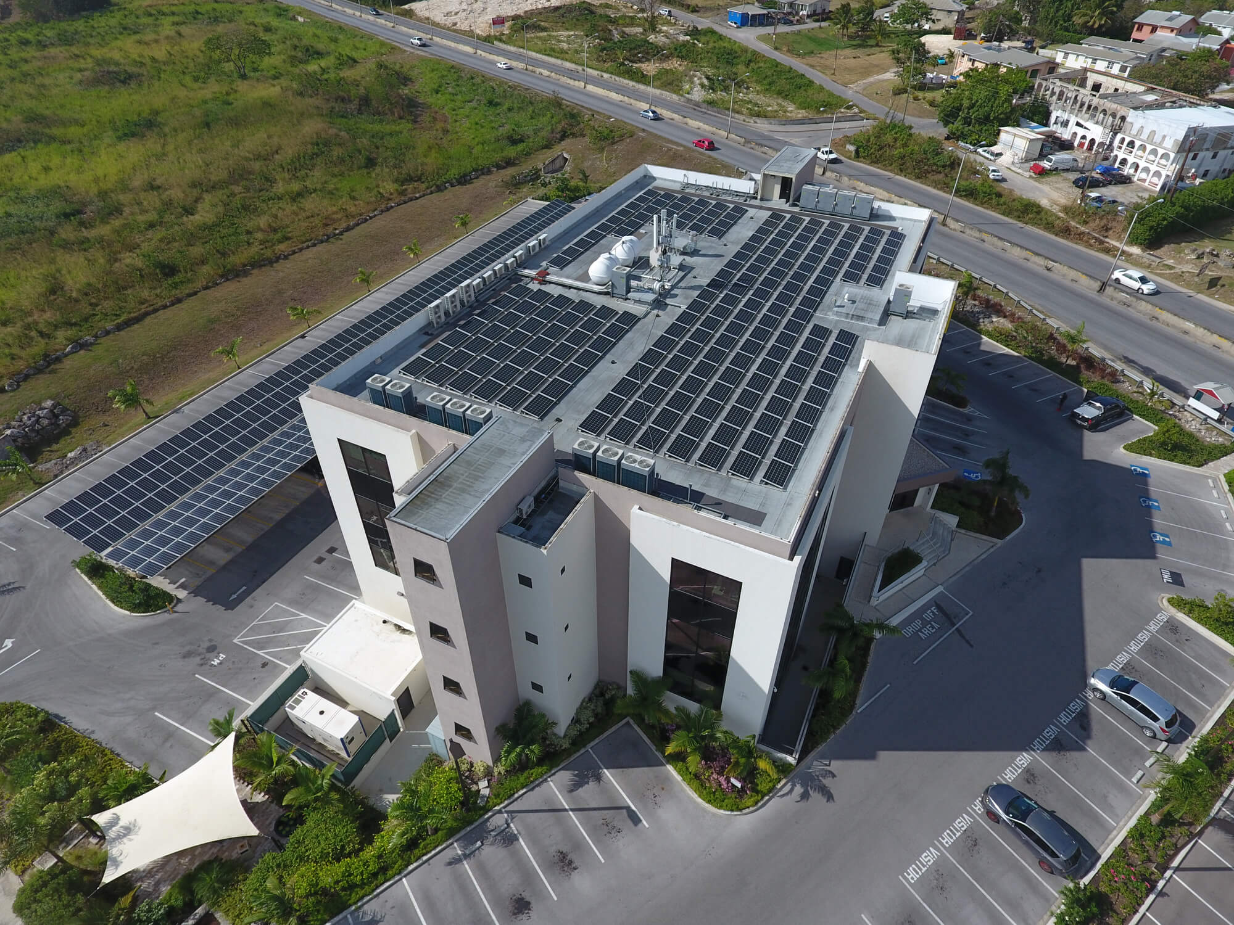
Canopy + Rooftop
BTM
FTM

Slide 14
Solar 101
Direct current (DC) is what the solar panels produce. ¹
Alternating current (AC) is what you use at home. ²
The electrical grid is typically AC.
One megawatt (AC) is roughly 5 to 8 acres.
1,000 kilowatts (kW) equals 1 megawatt (MW).
¹⁻² https://news.energysage.com/behind-the-meter-overview/

Slide 15
Solar 101
You can acquire acreage in different ways – land, parking garages, parking lots, rooftops, bodies of water, etc.
Legislation may limit the size of a project.
Local legislation is key (i.e., need a permit to build; watch out of local moratorium).

Slide 16
Things to Remember
Behind-the-meter (BTM) is on-site.
Front-of-the-meter (FTM) is off-site.
One megawatt (MW) is roughly 5 to 8 acres.
Be mindful of the legislation.

Slide 17
Example Solar Site
A land overview

Slide 18
Community Solar
A community solar project is an array of solar panels installed off-site. Anyone in the area (electric utility) can access the clean energy produced and receive credits toward their electricity bill.¹
¹ https://www.nyserda.ny.gov/All-Programs/Programs/NY-Sun/Solar-for-Your-Home/Community-Solar

Slide 19
New York Land Criteria for Community Solar
10 acres or more
On/near three phase power line
Within two (2) miles of the substation
No wetlands
No flood zone
Avoid shading
Avoid bad topography
In New York, CS sites are limited to 5 MW (ac) per project.

Slide 20
Within 2 miles of a substation
substation

Slide 21
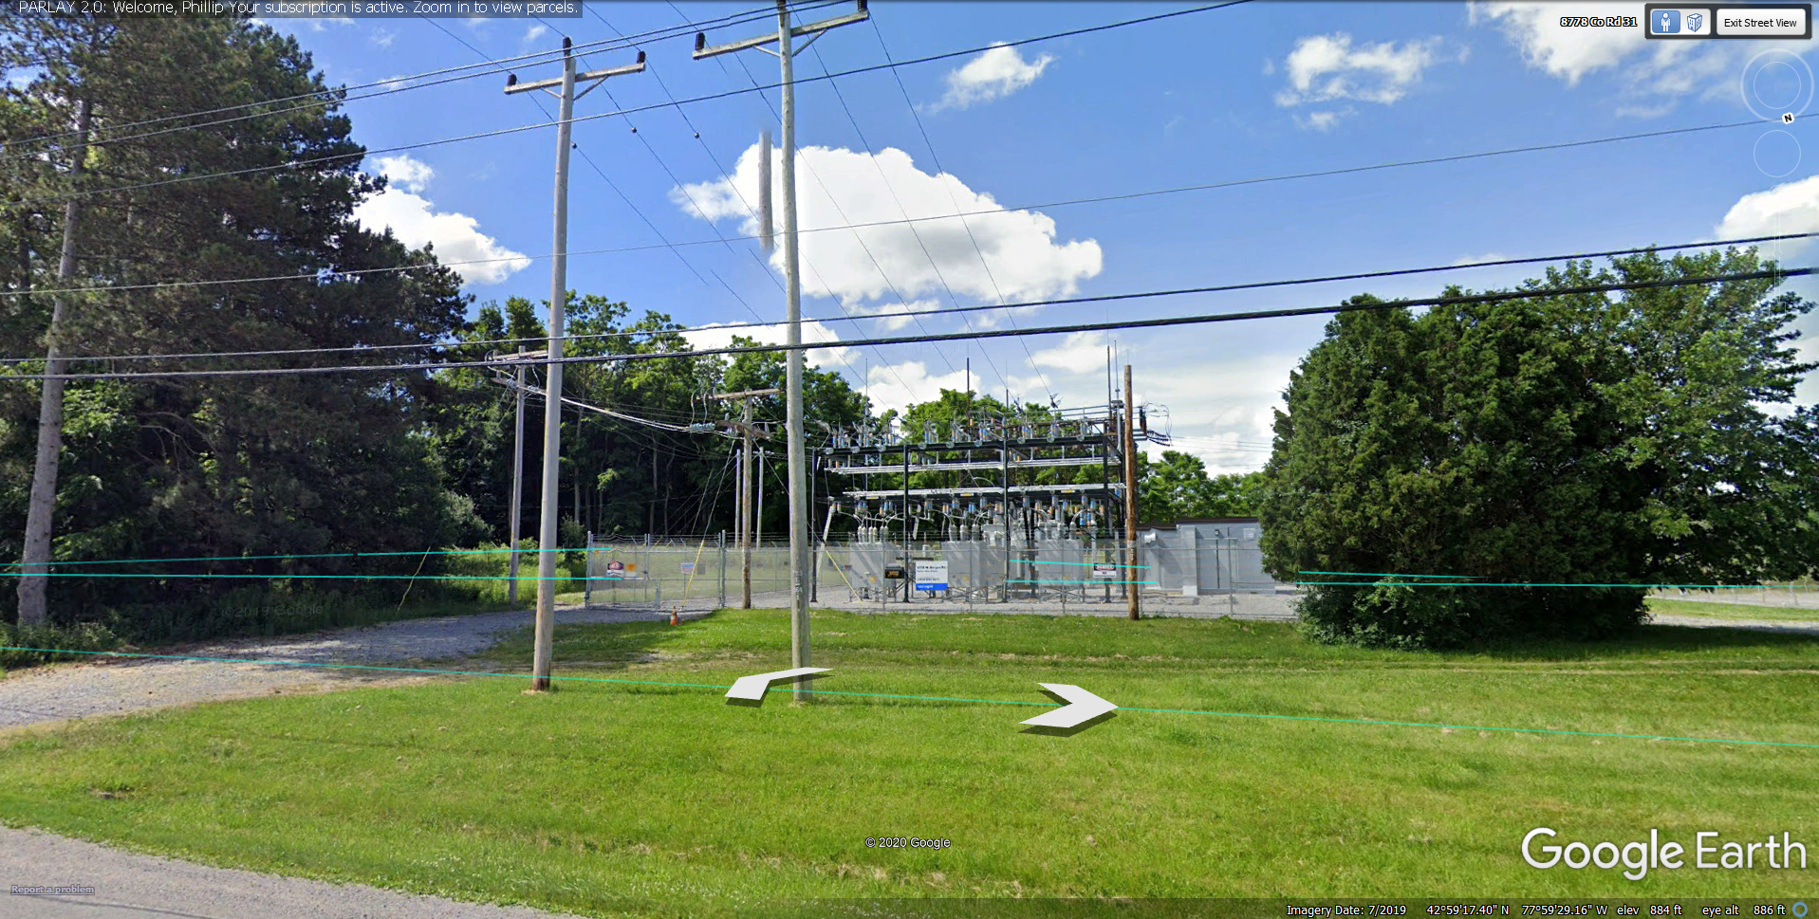
Within 2 miles of a substation

Slide 22
substation
On / near three phase power line

Slide 23
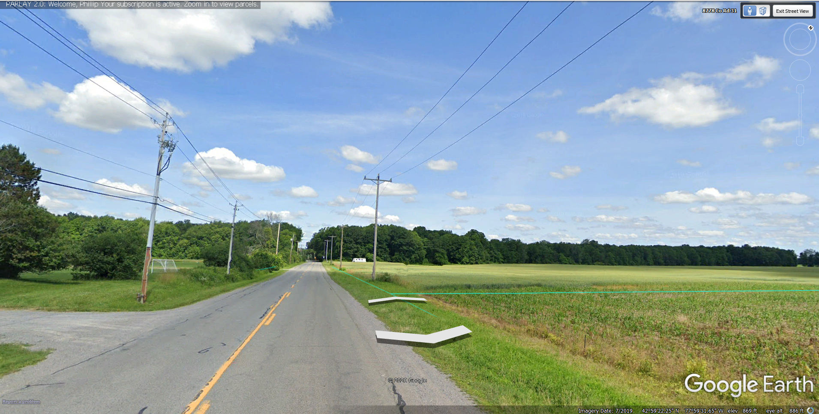
On / near three phase power line

Slide 24
5
6
4
3
2
1
10 acres or
more
substation

Slide 25
3
No wetlands
No flood plains
substation

Slide 26
Avoid water (e.g., stream)
substation

Slide 27
1
Avoid gov’t owned property
substation

Slide 28
5
6
4
3
2
1
Here are some good prospects
substation

Slide 29
Things to Remember
Find the substation.
Draw a one to two-mile radius around the substation.
Find the three-phase power/electric lines.
10 acres or more.
Avoid bad topography.
Avoid trees, if possible, to limit shading.
Avoid wetlands, flood plains, bodies of water, government-owned property.

Slide 30
Oil & Gas vs. Solar
A land overview

Slide 31
Operations are tied to the Geology
Operations are tied to the Legislation
O&G
vs.
Solar

Slide 32
O&G
vs.
Solar
¹ https://www.eia.gov/maps/images/shale_gas_lower48.pdf
² https://www.seia.org/states-map

Slide 33
Acquire interests in a Shale Play
Acquire interests in a Utility Territory
O&G
vs.
Solar

Slide 34
O&G
vs.
Solar
¹ http://geospatial.ohiodnr.gov/interactive-maps
² https://www.puco.ohio.gov/utility-maps/

Slide 35
You form a Drilling Unit
You tie into the Substation
O&G
vs.
Solar

Slide 36
O&G
vs.
Solar
Monroe County, Ohio
Monroe County, Ohio
¹ http://geospatial.ohiodnr.gov/interactive-maps
² https://www.monroecountyohio.com/government

Slide 37
Landman negotiates a Lease
Landman negotiates a Lease Option
O&G
vs.
Solar

Slide 38
O&G
vs.
Solar
Lease
Lease Option
10 acres 5-year primary 5-year secondary $5,000 per net acre Due within 120 days Drill or release (HBP) Unilateral termination
10 acres 2-year primary 1-year secondary $500 per calendar quarter Due within 60 days Exercise or release (no HBP) Unilateral termination

Slide 39
O&G
vs.
Solar
Lease
Lease
5-year primary 5-year secondary $5,000 per net acre No escalator Paid monthly HBP
20-year primary 5-year secondary $1,000 per buildable acre 1-2% escalator Paid quarterly/annually Cannot HBP

Slide 40
O&G
vs.
Solar
Key Terms
Key Terms
Royalty clause (net, gross, ME) Surface restriction clause Depth restriction clause Shut-in clause Pugh clause
Rent escalator Mineral restriction clause Access clause Decommissioning clause Taxes

Slide 41
Questions?
Event sponsor:
pguerra@forefrontpower.com
linkedin.com/in/phillip-guerra

